Slide 1
CEGE0096: Geospatial Programming
Lecture 4: Object-Oriented Programming
Dr. Aldo Lipani

Slide 2
Imperative Programming (RECAP)

Slide 3
Our Python (Imperative) Journey
Types
Operators
Variables
Simple I/O
Branching
Loops
Functions
Program Planning
Strings
Tuples
Lists
Sets
Dictionaries
Files
Covered in the 1st Lecture
Covered in the 2nd Lecture
Covered in the 3rd Lecture

Slide 4
Review Exercise 5
Given a sequence of numbers inputted by the user compute the following statistics:
min,
max,
average,
number of duplicates, and
mode.
You should define a function for each one of these statistics.
TIP: these functions should take as input a sequence of numbers.
Notes:
3

Slide 5
Solution
print('Describe My Sequence (0.1)')
# functions go here
n = int(input('How many values? ')) l = [] for i in range(n): v = float(input('Insert number ' + str(i + 1) + ': ')) l.append(v) print('The statistics are:') print('* Min:', min(l)) print('* Max:', max(l)) print('* Avg:', average(l)) print('* Dup:', duplicates(l)) print('* Mod:', mode(l))
Notes:
4

Slide 6
Solution (I)
def min(vs): res = vs[0] for v in vs[1:]: if v < res: res = v return res
1
5
-2
5
10
12
Notes:
5

Slide 7
Solution (II)
def max(vs): res = vs[0] for v in vs[1:]: if v > res: res = v return res
1
5
-2
5
10
12
Notes:
6

Slide 8
Solution (III)
def average(vs): res = 0 for v in vs: res = res + v res = res / len(vs) return res
Notes:
7

Slide 9
Solution (IV)
def duplicates(vs): s = set() res = 0 for v in vs: if v not in s: s.add(v) else: res = res + 1 return res
Notes:
8

Slide 10
Solution (V)
def mode(vs): f = {} for v in vs: if v not in f: f[v] = 0 f[v] = f[v] + 1 res = vs[0]
m = f[res] for k, v in f.items(): if v > m: res = k
m = v return res
1:1
5:2
1
5
-2
5
10
12
-2:1
5
vs
10:1
res
f
12:1
Notes:
9

Slide 11
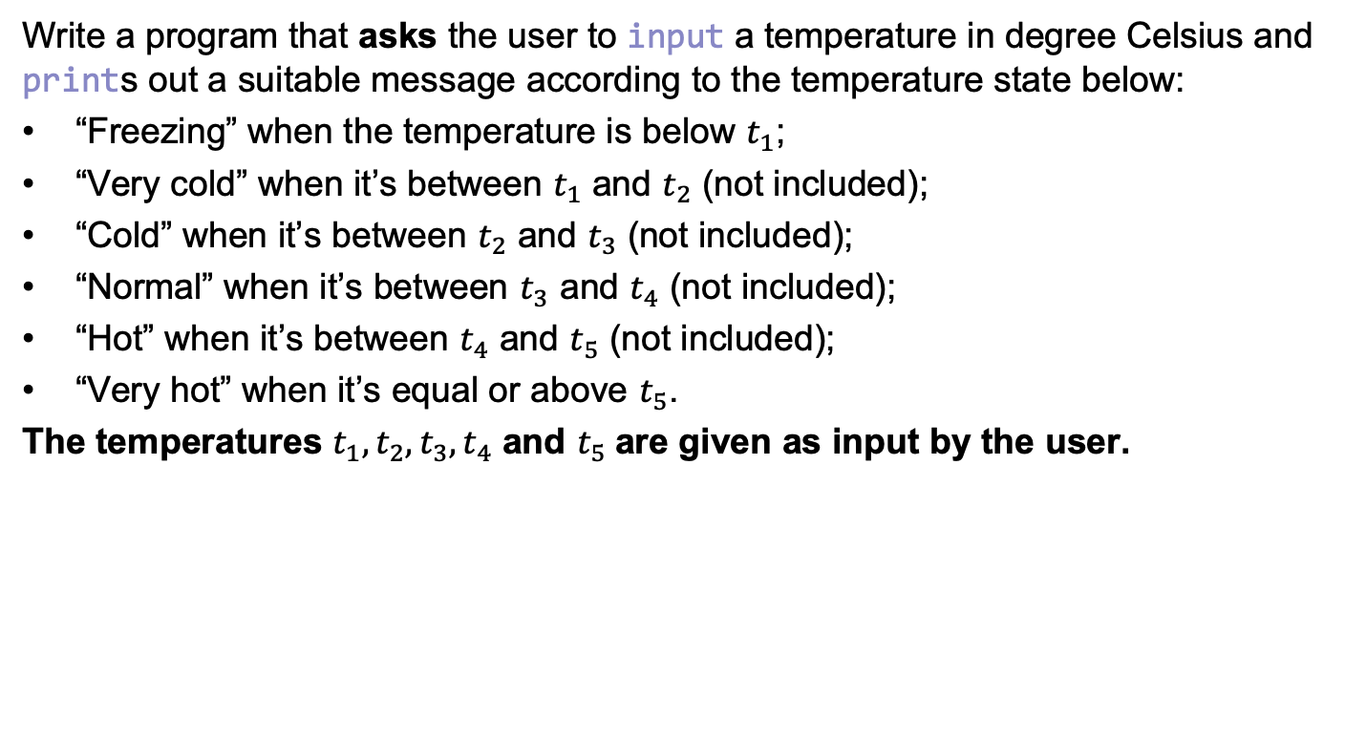
Review Exercise 6
Write a program that asks the user to input a temperature in degree Celsius and prints out a suitable message according to the temperature state below:
“Freezing” when the temperature is below $t_{1}$;
“Very cold” when it’s between $t_{1}$ and $t_{2}$ (not included);
“Cold” when it’s between $t_{2}$ and $t_{3}$ (not included);
“Normal” when it’s between $t_{3}$ and $t_{4}$ (not included);
“Hot” when it’s between $t_{4}$ and $t_{5}$ (not included);
“Very hot” when it’s equal or above $t_{5}$.
The temperatures $t_{1}, t_{2},t_{3},t_{4}$ and $t_{5}$are given as input by the user.
Notes:
10

Slide 12
Solution
print('Temperature to Perceived Temperature Converter (0.3)') perceived_temps = ['freezing', 'very cold', 'cold', 'normal', 'hot', 'very hot'] temps = [] for i in range(5): temp = float(input('To which temperature you feel like is no longer ' + perceived_temps[i] + '? ')) temps.append(temp) temp = float(input('What temperature is outside? ')) perceived_temp = perceived_temps[-1] not_found = True i = 0 while not_found and i < len(temps): if temp < temps[i]: perceived_temp = perceived_temps[i] not_found = False i = i + 1 print('Your temperature today is', perceived_temp)
for i in range(len(temps)): if temp < temps[i]: perceived_temp = perceived_temps[i] break
Notes:
11

Slide 13
Object-Oriented Programming

Slide 14
Our Second Python (OOP) Journey
Class
Object
Attribute
Method
Inheritance
Polymorphism
Encapsulation

Slide 15
Why Object-Oriented Programming?
Object-oriented programming (OOP) derives from the software crisis of the 60’s.
Problem: the overall complexity of hardware and the software development process was increasing.
Indicators:
Projects running over budget or over time
Inefficiency and low quality of software
Failure of software to meet the requirements (including delivery)
Unmanageable projects and unmaintainable code

Slide 16
Object-Oriented Programming
Imperative programming (non-Object-oriented) method can cause software to be extremely difficult to maintain.
Code is hard to reuse in other projects.
OOP is a programming paradigm that attempts to address these issues by structuring the code into classes.

Slide 17
Some Key Terms in OOP
A class is a template for making objects, containing attributes and methods.
An object is an instance (or concretization) of a class.
An attribute is a variable that belongs to an object. Attributes define the state of an object.
A method is a function that belongs to an object that operates with the attributes.

Slide 18
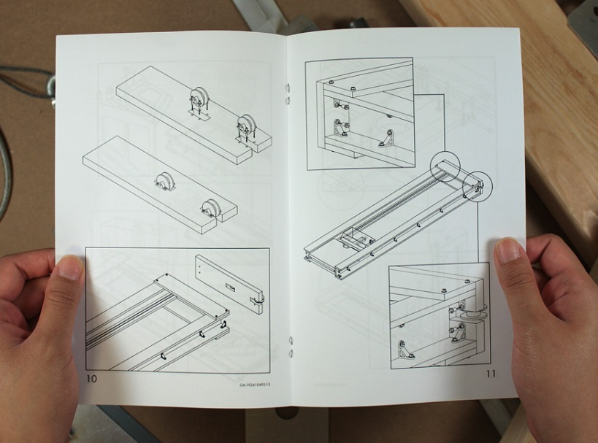

Classes vs. Objects
We can change (or perhaps break) an object without changing the class (i.e. we can put the legs on the chair the wrong way but the instructions don’t change).
If the class is well-defined, the object should be hard to break (to not be used as designed).
Class: Defines the way in which an object should be constructed.
Object: It is a single instance of the class, constructed using the class definition.
Notes:
17

Slide 19
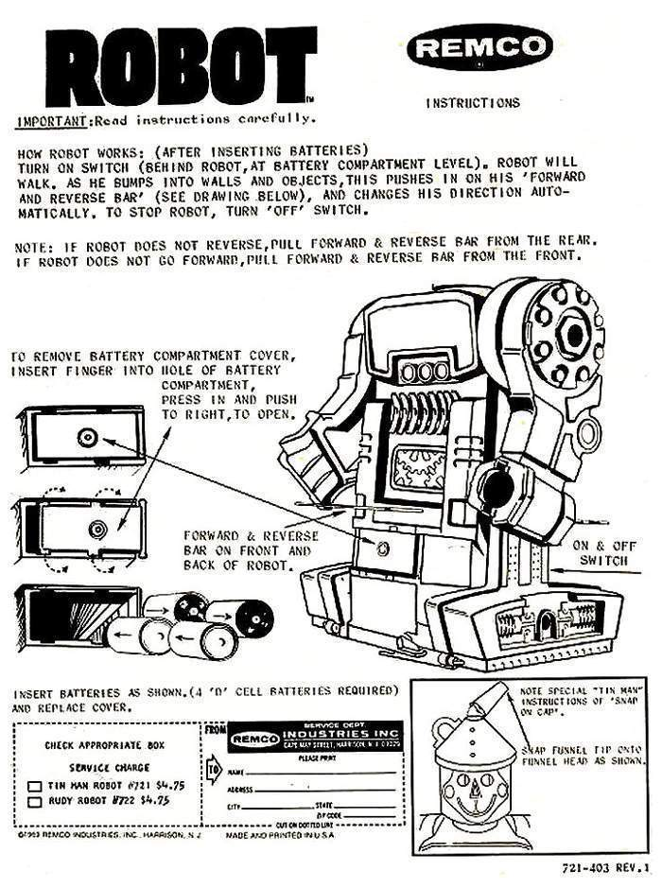
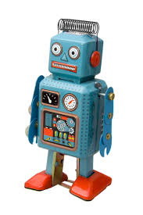
Attributes vs. Methods
Class: Robot
Object: Sparky
Attributes:
height
number of arms
battery life
Methods:
walk()
speak()
shoot()
Typical usage
sparky = Robot(50) # Create an instance of the robot class with height 50 sparky.shoot() # Use the shoot method "Pew pew pew!" # Perhaps the shoot method outputs this string
Notes:
18

Slide 20
You Already Worked with Objects
Examples are data structures:
A set is a class which has attributes and methods.
When you reference a set in your code, you are creating a set object.
Create an instance of a set:
s = set()
Add is a method of the class set that changes the internal state of the set:
s.add(10)
You’ve worked with classes, objects, attributes, and methods; now you will create them.

Slide 21
A Class in Python
class Robot: def __init__(self, name): # Constructor self.name = name # Attributes self.ammunition = 99 def shoot(self): # Method if self.ammunition > 0: print('Pew pew pew!') self.ammunition = self.ammunition - 3 else: print('No pew...')
Notes:
20

Slide 22
Basic Class
self (this in Java and C++) is the first parameter of every method inside a class.
The attributes of a class are stored locally in every instance (object).
self is the way that methods can access data stored within the object.
super() is used to refer to the parent class. Commonly seen when redefining the constructor of a sub-class.
Notes:
21

Slide 23
OOP Features
Inheritance. The ability to create a child (sub-)class from a parent (super-)class inheriting its attributes and methods. This enables hierarchical data structures and avoids code repetition.
Polymorphism. The ability to override methods of a parent class in a child class, changing how methods work depending on the context.
Encapsulation. Access to attributes and methods is under the control of the programmer (e.g. “public” or “private” attributes; “public” or “private” methods)

Slide 24
Inheritance
One of the most useful features of OOP is the ability of classes to inherit attributes and methods from a parent (or super) class.
Defining common properties and methods in a parent class allows child (sub) classes to have access to them without repetition of code.
Inheritance can reduce the overall size of a program and make it much easier to debug:
Fixes in a parent class will apply to all child classes automatically;
Problems with a child class will not affect its parent class.
Inheritance also allows neat hierarchical representations of some real world phenomena and processes.

Slide 25
Inheritance: Class Diagram
A Unified Modeling Language (UML) class diagram is a type of static structure diagram that describes the structure of a computer program. It shows the program’s classes, their attributes and methods, and their parent-child relationships with one another.
Parent
Here, Parent is a parent of the two child classes
my_attribute: int
do_action()
Child1
Child2
my_attribute_1: int
my_attribute_2: int
do_action()
do_action()

Slide 26
Example: Animal Class
Animal
name: str
talk()
Dog
Cat
talk()
roll_over()
talk()
Cats and dogs are both animals, so share some common properties and methods.
Notes:
25

Slide 27
Animal Class Diagram
Animal
Reptile
Bird
Mammal
Snake
Lizard
Parrot
Horse
Bat

Slide 28
Inheritance: How is it done?
class Animal: def __init__(self, name): self.name = name def talk(self): print("I don't know how to talk!") class Dog(Animal): def talk(self): print('Woof!') class Cat(Animal): def talk(self): print('Meow!')
Notes:
27

Slide 29
Multiple Inheritance
A class can inherit from multiple parent classes.
class Animal: def __init__(self, name): self.name = name def talk(self): print("I don't know how to talk!") class Mammal(Animal): def milk(self): print("I don't know which milk!")
class Bat(Mammal, Winged): def talk(self): print('Bat-voice!') def milk(self): print('Bat milk')
class Winged(Animal): def fly(self): print('Flap flap flap!')

Slide 30
Polymorphism
Polymorphism allows the same function or method to be used in different ways depending on the context.
In OOP, polymorphism is often used to override methods of a parent class in a child class.
e.g. the talk methods in the animal examples
It also allows functions to operate differently depending on the data supplied to them.
E.g. the + operator functions differently depending on integer, string and float input
print('Hello' + 'There') # Two strings print(1 + 2) # Two integers print(['A', 'B'] + ['C']) # Two lists

Slide 31
Polymorphism
class Animal: def __init__(self, name): self.name = name def talk(self): print("I don't know how to talk!")
def talking_animal(animal): animal.talk() talking_animal(Cat('Fluffy')) talking_animal(Dog('Spot'))
Notes:
30

Slide 32
Encapsulation
Encapsulation describes the idea of using methods to manipulate the data within an object.
This concept is also often used to hide the internal representation, or state, of an object from the outside.
So far, we have used only public attributes and methods. This means that these are accessible from outside.
You can disallow this access by using private attributes and methods.

Slide 33
Encapsulation
Encapsulation is used to control the way in which users interact with the properties and methods within a class.
You can use a double underscore (__) to make an attribute or a method private.
class Animal: def __init__(self, name): self.__name = name # This attribute is now private def __method(self): # This method is private print('This method can be called only by myself!') def talk(self): print("I don't know how to talk!")

Slide 34
Private Attributes
If an attribute is private this cannot be accessed from outside or by a child class.
To access these attributes it is common to use getter and setter methods, based on whether you want to provide read or write rights or have some control over these operations.
class Animal: def __init__(self, name): self.__name = name def get_name(self): return self.__name def set_name(self, name): self.__name = name

Slide 35
Summary
OOP has advantages over procedural programming:
Less code repetition;
Easier debugging.
Centered around objects, which are instances of classes.
Classes contain attributes (variables) and methods (functions).
Key features: inheritance, polymorphism, and encapsulation.
Well suited to hierarchical data modeling.

Slide 36
Exercise 7 (30 Minutes)
Design an object-oriented program for the following classes:
Geometry, Point, Line, Polygon, Triangle and Square.
This program should allow the construction of:
A point;
A line given two points;
A polygon given 3 or more points;
A triangle given 3 points;
A square given its bottom left point and its side length.
These classes should implement the methods to get or compute (where and when appropriate): the name, the x, the y, the lines, and the area.
TIP: use the Shoelace Formula to compute the area of a triangle given 3 points.
Notes:
35

Slide 37
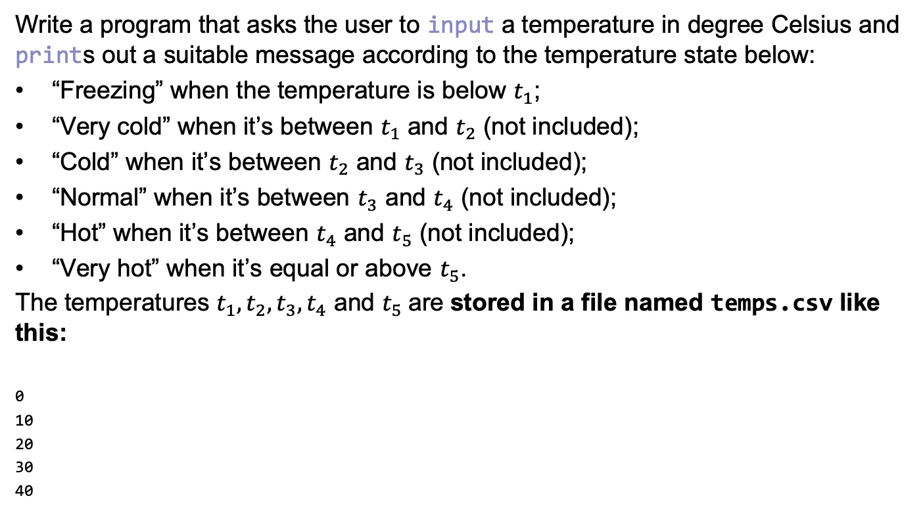
Exercise 8 (10 Minutes)
Write a program that asks the user to input a temperature in degree Celsius and prints out a suitable message according to the temperature state below:
“Freezing” when the temperature is below $t_{1}$;
“Very cold” when it’s between $t_{1}$ and $t_{2}$ (not included);
“Cold” when it’s between $t_{2}$ and $t_{3}$ (not included);
“Normal” when it’s between $t_{3}$ and $t_{4}$ (not included);
“Hot” when it’s between $t_{4}$ and $t_{5}$ (not included);
“Very hot” when it’s equal or above $t_{5}$.
The temperatures $t_{1}, t_{2},t_{3},t_{4}$ and $t_{5}$are stored in a file named temps.csv like this:
0
10
20
30
40
Notes:
36

